Slide 1

RASPBERRY PI
DIGITAL FORENSICS PROJECT
GROUP PRESENTATION BY: ‘404 NOT FOUND’ - ALEX, CAMERON, JAMES, MATT, SERGEY, SEBASTIEN

Slide 2
COMPROMISED RASPSBERRY PI EVIDENCE GATHERING:
On 8th of February our forensics team was informed of a compromised system that had been used for illicit activities of unknown nature.
Our team was tasked to discover how the system was used
& to discover the suspect involved.
In accordance with adhering to ACPO Principle 3 and preserving original evidence, a forensic image was made of the compromised Raspberry Pie and handed over to the team for further analysis.

Slide 3
The following set of slides will display the main sources of evidence coming from
programs/files/commands,
followed by a brief description ,
& entries from our contemporaneous notes.

Slide 4
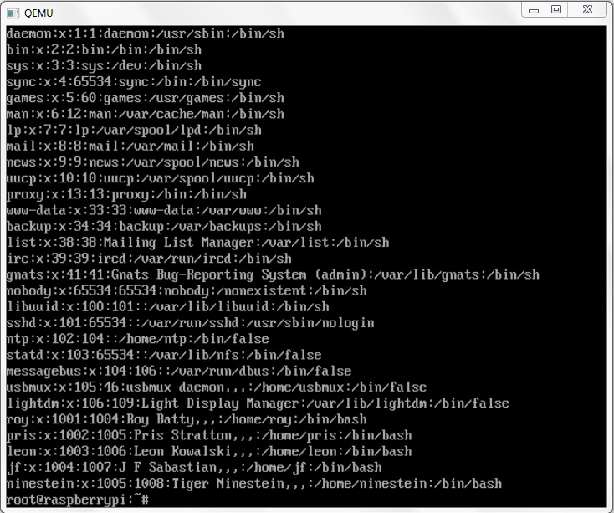
#/etc/password
A table of current users along with their associated Principles, UID’s, and GUID’s.
Feb 18 13:48 – Discovered system principals: root, roy, pris, leon, jf, ninestein
Principal-root UID-0 GID-0
Name- Roy Batty Principal-roy UID-1001 GID-1004
Name- Pris Stratton Principal-pris UID-1002 GID-1005
Name- Leon Kowalski Principal-leon UID-1003 GID-1006
Name- J F Sabastian Principal-jf UID-1004 GID-1007
Name- Tiger Ninestein Principal-ninestein UID-1005 GID-1008

Slide 5
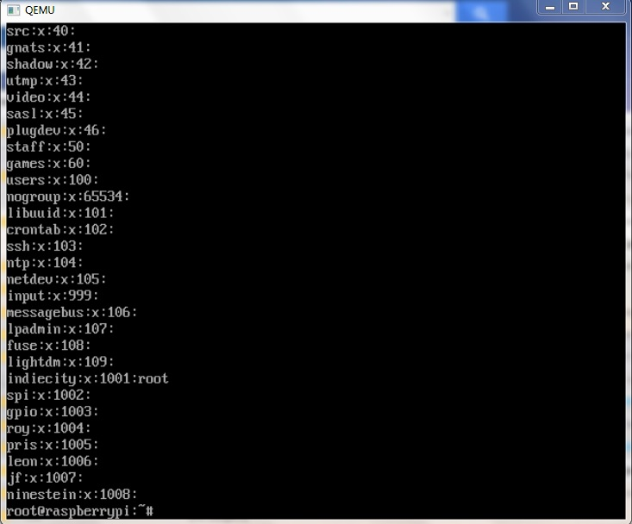
#/etc/group
A table of principals along with their associated group membership.
Feb 18 13:50 – Discovered groups associated to system principals:
Principle- roy Groups-1004
Principle- pris Groups- 1005
Principle- leon Groups- 1006
Principle- jf Groups- 1007
Principle- ninestein Groups- 1008

Slide 6
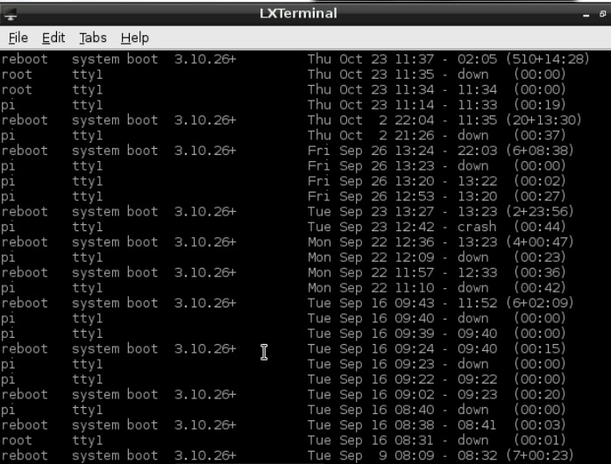
Cmd: last
A command that displays list of users logged in since /var/log/wtmp was created.
Feb 18 14:00 –Significant usage dates: Sept 16, 22, 26 & Oct 23
Besides root, the ‘pi’ user was the only user that ever logged in
However, there is no longer a ‘pi’ system user.
Examining the home directory & passwd- file (backup of passwd) also revealed the pre-existence of a ‘pi’ system user.

Slide 7
#/var/logs/auth.log:
A log of all history relating to PAM authenticated sessions & usage of sudo commands.
Feb 18 14:07 - Confirmed the system was first logged on the 16th.
The creation of all other users took place on the 22nd Sept.
Numerous cron sessions were established on the Sept 23rd , 26th , & Oct 23rd.
The deletion of ‘Pi’ took place on the 23rd Oct with root user.
Various sudo commands & corresponding timestamps found.
(Info was given to the team that the system administrator purposely added the 5 users & this was a legitimate operation.
Also, administrator had used the default ‘pi’ username before it was compromised.)

Slide 8
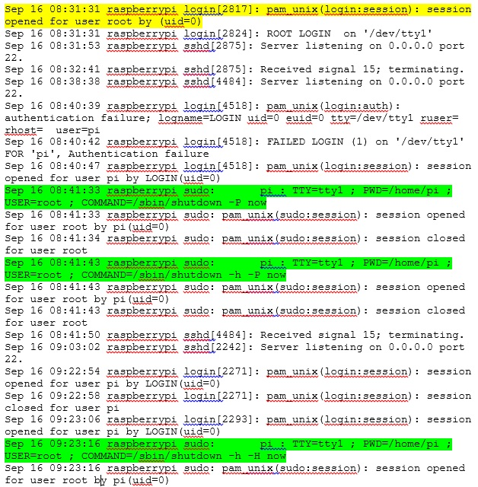
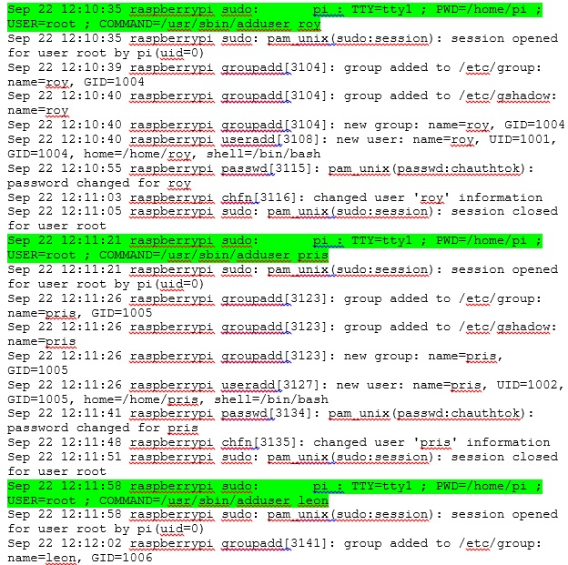
#/var/logs/auth.log
(FIRST SYSTEM LOGIN SEPT 16TH)
(LEGITIMATE USERS CREATED Sept 22nd)

Slide 9
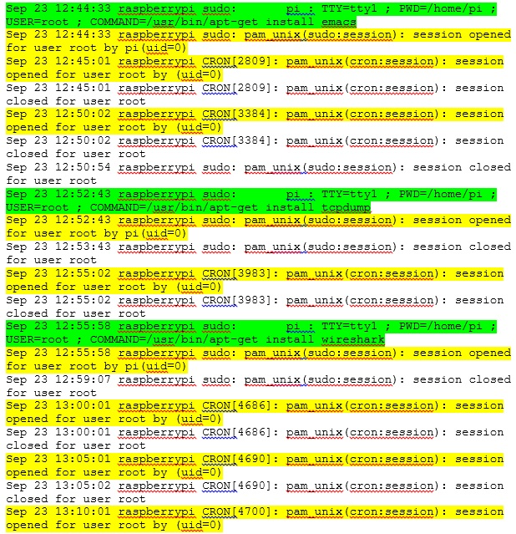
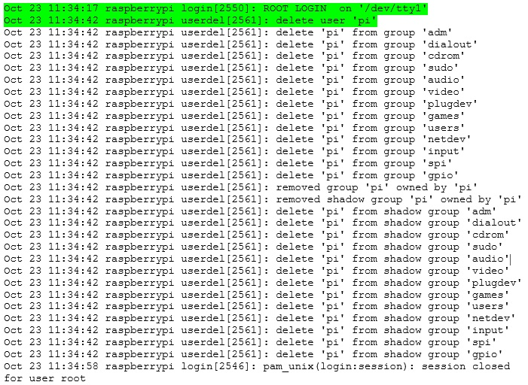
#/var/logs/auth.log
(‘PI’ DELETED ON OCT 23RD )
(NUMEROUS CRON SESSIONS ESTABLISHED)

Slide 10
#/var logs/syslog:
A syslog log containing messages of various system wide events.
These include: kernel mssgs, user-level mssgs, mail system messages,
authentication mssgs, scheduling daemon mssgs (cron), etc….
Feb 18 16:35 - Discovered system info:
Syslogd version 5.8.11
Linux Version: 3.10.26
Processor: ARM 6 compatible; revision (ARM v7)
- crontab editing:
crontab edited by ninestein & root on Sept 22nd
crontab edited by root on Sept 23rd
cron sessions scheduled to run ‘ No5 ‘ every 5 mins
crontab edited by root on Oct 23rd
cron sessions scheduled to run ‘ No5 ’ every 1 mins

Slide 11
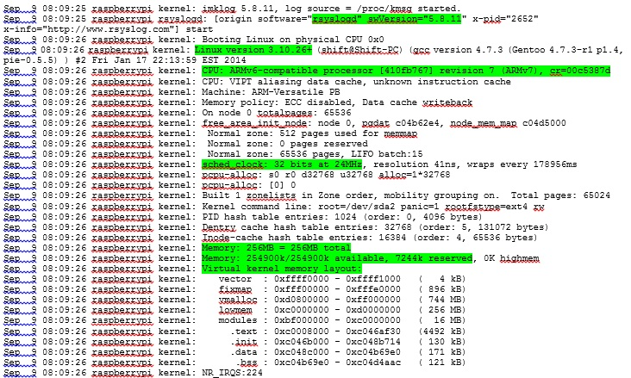
(SYSTEM INFORMATION)

Slide 12
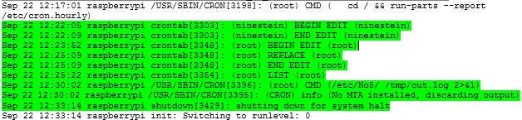
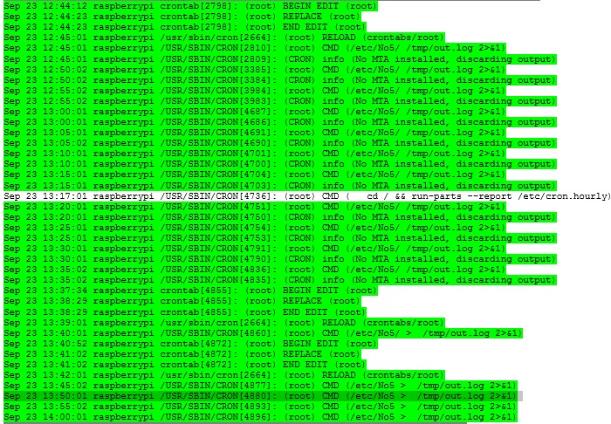
(NINESTEIN & ROOT EDITING CRONTAB)
(SEPT 23RD CRON SESSIONS SCHEDULED TO RUN ‘No5’ EVERY 5 MINS)

Slide 13
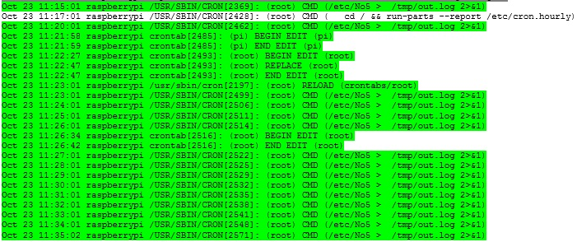
(OCT 23RD CRON SESSIONS SCHEDULED TO RUN ‘No5’ EVERY 1 MIN !?!? )

Slide 14
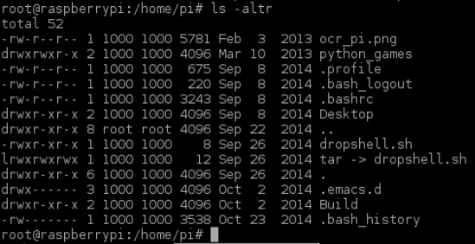
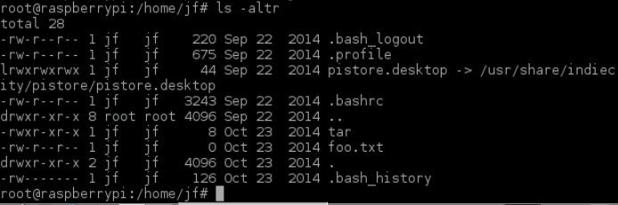
SIGNIFICANT CONTENT OF USER ‘s /HOME DIRECTORIES
/home/root -
.bash_history
/home/pi -
.bash_history
/home/pi/Build -
compress & compress.c & compress.man~
No5 & No5.c
Dropshell.sh
tar(symlinked to dropshell.sh)
dropshell.sh
/home/jf -
.bash_history
foo.txt
tar

Slide 15
CRITICAL EVIDENCE: ‘No5’ & COMPRESS
#/home/pi/Build/No5.c
Feb 23rd 12:25 – Examined source code of the No5 program.
- Program is written in C++ & designed to setup a socket connection.
- The program has been adapted to set up the client side of the network connection
- The program has been set to connect to an internal server (creative.coventry.ac.uk) on
192.168.72.48 and to listen on port 9997 (This port uses a chat application called “The Palace”).
- It connects & sends the string ‘command’ to the server before waiting for a response.
#/home/pi/Build/compress.c
Feb 23rd 18:00 – Examined source code of the No5 program.
-Source code of compress shows this is a program supposedly built
to act as a shortcut for the tar archive program.
- The shortcut allows for a user to use the command ‘tar’ in order to perform the
‘tar cvf’ command. This relieves the user from having to remember specific flags.

Slide 16
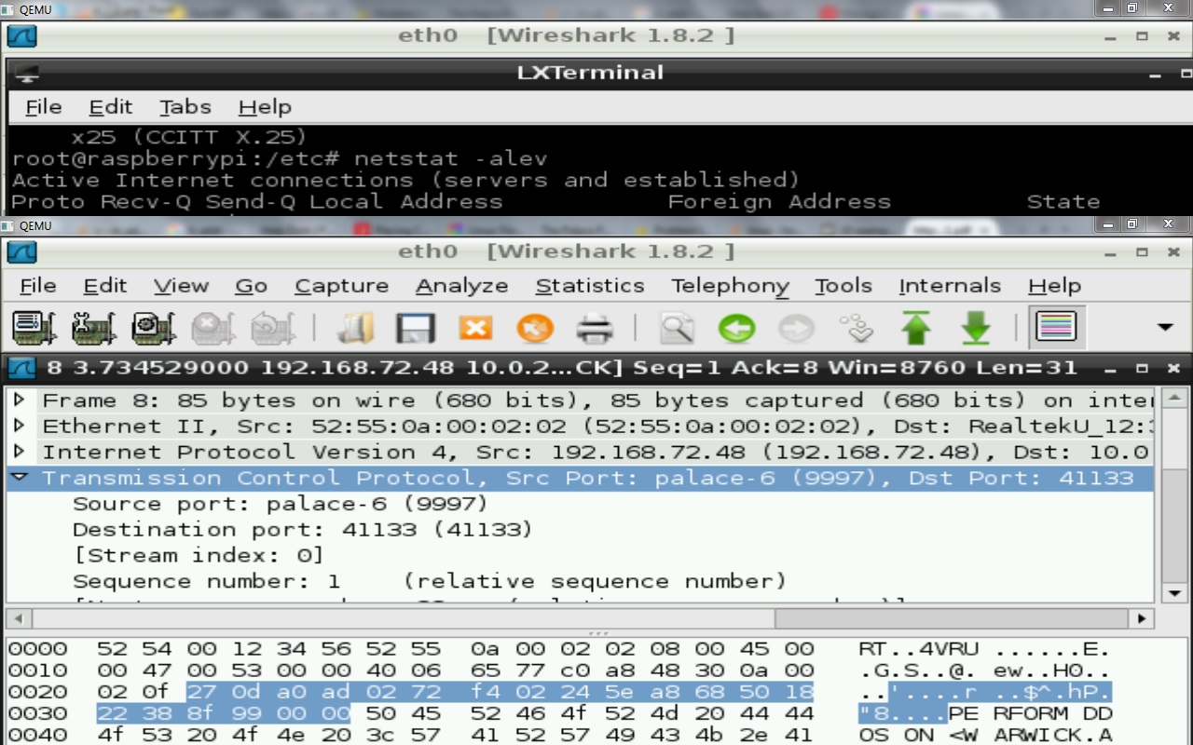
CRITICAL EVIDENCE: ‘No5’ & WIRESHARK
After learning that No5 establishes a socket connection and learning from our logs that it is scheduled to run via a crom sessions,
We decided to examin the packets transferred and made a break through discovery……
After the client connects to an internal server by sending the ‘command’ string, the client responded with a command showing intent to connect to warwick.ac.uk. And ultimately perform a DDOS attack.
This is the reason why the attacker edited cron to run No5 every single minute.
This machine was intended to be used as part of a botnet.

Slide 17
CRITICAL EVIDENCE: .bash_history
#/home/<user>/.bash_history:
List of previous bash commands executed by users.
We managed to discover .bash_history files from ‘root’, ‘pi‘, & ‘jf’.
We correlated the commands to associated timestamps found in log files and file metadata & were able to build a pretty decent timeline of events that lead to the following conclusion…..

Slide 18
On Sept-26 - No5 & compress are compiled using gcc by the “well meaning” sys admin ‘Will Meaning’ using the default ‘pi’ username.
- ‘pi’ has sudoer permissions.
- The sudo command is used to copy No5 to /etc
- The sudo command is used to copy compress to /usr/bin
(/usr/bin is a directory set in PATH environment variable. So when ‘compress’ is typed in the command line it will run no matter what the present working directory is as the system knows to search directories set in PATH)
(At this point the No5 & compress files that were copied using sudo are effectively’ owned as ‘root’ )
- The No5 program has its SUID bit set (The program can be run by other users effectively having owner/root permissions)
On Oct 23 - J F Sabastian logs into his account with the username ‘jf’ .
+11:19 – jf creates a txt file named ‘tar’ and makes it executable.
(tar contains a script to execute an interactive shell : /bin/sh )
- jf adds the directory that contains the tar file to the beginning of the PATH environment variable.
(so if ever ‘tar’ is called it will search this directory before searching for the directory of the genuine tar program.
+11:21- jf created a bogus file named foo.txt
jf executes the compress program and passes in foo.txt as an argument.
- The compress file now runs with root privileges as dictated by the SUID bit.
-The compress file runs the bash command ‘ tar xvf ‘
-The system searches for tar , finds it in the PATH variable directory containing the tar script.
- The tar script is run as root as it inherits permissions of the principal (compress).
- jf now runs an interactive shell as a ‘ root ‘ user.
+11:22 - jf edits the crontab to run No5 every minute in order to DDOS warwick.co.uk
+11:34 -if deletes the ‘pi’ account in order to ensure that Will meaning does not gain access any time soon.

